Slide 1
Rural Surge
Fernando, Mindy, Sebastian, Teresa

Slide 2
Tools Used on Project
GitHub
The largest and most advanced development platform in the world.
https://github.com/
Pandas
A fast, powerful, flexible and easy to use open source data analysis and manipulation tool, built on top of the Python programming language
https://pandas.pydata.org/ built on top of the Python programming language.
Python
A general-purpose, versatile, and powerful programming language.
https://www.python.org/
QuickDBD
A simple online tool to quickly draw database diagrams.
https://www.quickdatabasediagrams.com/
GeoJSON
A format for encoding a variety of geographic data structures.
https://geojson.org/
Tableau
A visual analytics platform transforming the way we use data to solve problems—empowering people and organizations to make the most of their data.
https://www.tableau.com/

Slide 3
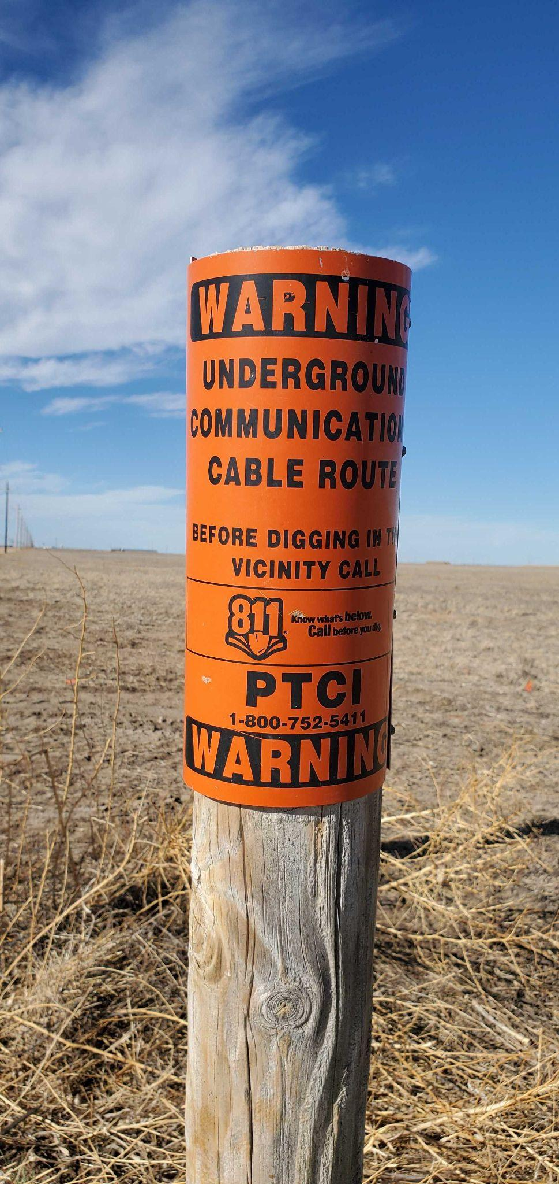
Topic
The 2020 pandemic highlighted a dearth of high-speed internet connection in Kansas' tiny rural areas.
In the fall of 2020, schools were shuttered, and emergency remote teaching became the means of addressing educational delivery.
It became clear that not all internet is created equal.
Many members of the community only had access to cellphone data, making participation in an online learning environment unfeasible.
Those who did have access to the internet had so slow download speeds that they couldn't engage in online class activities.
Our team decided to look into the internet's availability and quality in Kansas.

Slide 4

Data Gathering
Looked at FCC (Federal Communications Commission)
Internet Providers and speeds correlated with location
US Census Bureau
Population Density
Kansas State Library
Ks_county_codes.csv, ks_county_lat_long.csv, ks_county_lat_long_txt_format.csv, ks_county_population.csv, ks_poverty_by_county.csv, ks_school_dist_codes.csv, ks_school_dist_county_pop_poverty.csv

Slide 5


Questions we hope to answer with the data
How does internet access support (quality, availability, etc) compare between rural and urban areas in Kansas?
What Internet Service Providers (ISPs) are available in Kansas? How does their support vary between rural and urban communities?

Slide 6
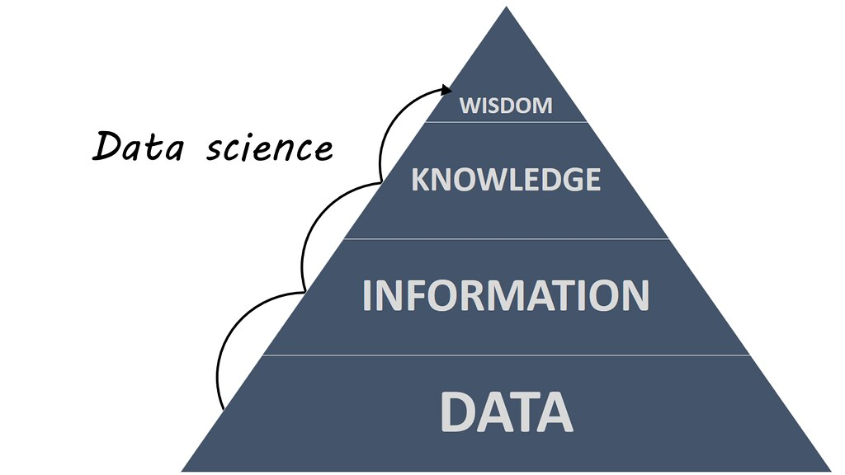
Data Exploration Phase
Our team decided to use Tableau to do our data exploration.
Placeholder

Slide 7
Analysis Phase
Placeholder

